Slide 1

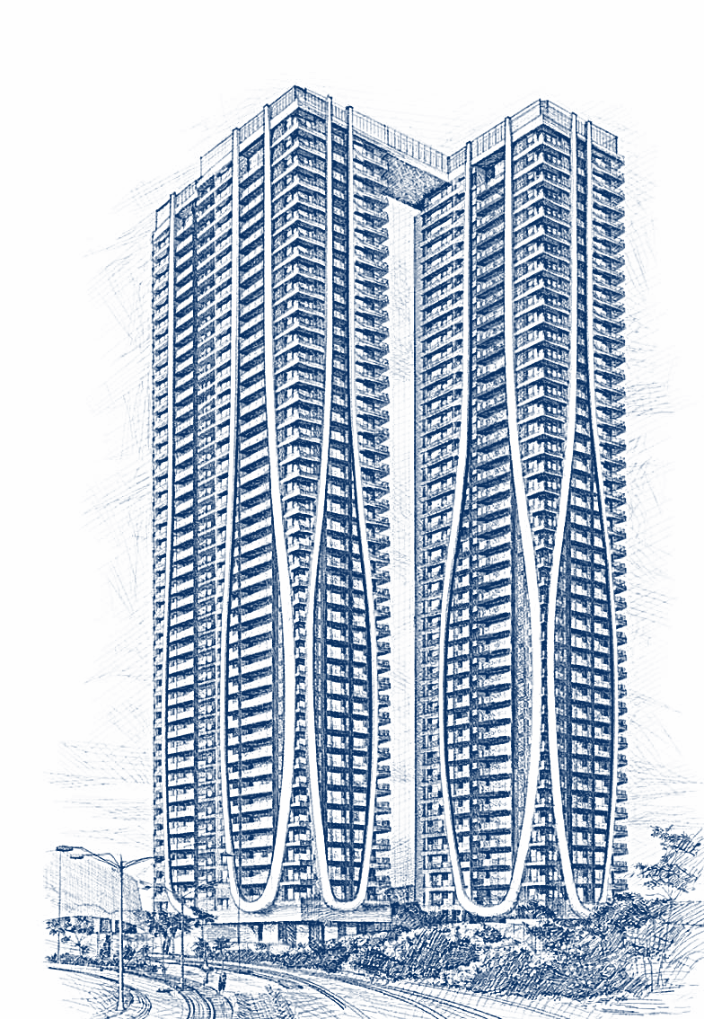
Poster ID
TITLE OF PROJECT
Authors:
First Author¹
Second Author²
Third Author³
Fourth Author⁴
Affiliations:
First Author¹, University Name, State, Country
Second Author², University Name, State, Country
Third Author³, University Name, State, Country
Fourth Author⁴, University Name, State, Country
INTRODUCTION
The introduction should briefly present the background and motivation of the study, highlighting the engineering significance of the problem being addressed. It should clearly define the problem statement, explain its relevance to current practice or research, and identify the gap in existing studies. The section should conclude with a concise statement of the objective(s) of the work without going into detailed literature review or methodology.
METHODOLOGY
This section should describe the overall approach and procedures adopted to carry out the study. It should include information about the type of structure or model considered, analysis or experimental techniques used, software tools employed, loading conditions, and applicable design codes or standards. Key assumptions and parameters should be briefly stated, and the use of diagrams, flowcharts, or model schematics is encouraged to improve clarity.
RESULTS
DISCUSSIONS
The results section should present the key outcomes obtained from the analysis or experimentation in a clear and concise manner. Quantitative results should be highlighted using graphs, tables, and figures wherever possible. Only the final observations and critical values should be reported in this section, without interpretation or comparison.
The discussion should interpret and explain the results presented earlier by identifying trends, relationships, and underlying reasons for the observed behavior. It should relate the findings to the objectives of the study and, where relevant, compare them with previous studies or expected theoretical behavior. The practical implications and limitations of the results may also be briefly discussed.
CONCLUSIONS
REFERENCES
This section should briefly summarize the main findings of the study and state whether the objectives were achieved. Key technical insights and practical implications may be highlighted, with a short mention of future scope if space allows.
Include only the most relevant references cited in the poster, formatted consistently according to the conference guidelines and limited in number due to space constraints.
Notes:
The posters can be submitted by a student only.
Maximum 2-posters can be submitted by the first author (student).
Step-1
First author must register using kerberos ID.
A registration number will be generated.
Step-2
1. Use poster template and write the generated “Registration Number” in the box provided in the poster template.
2. Keep minimum size of heading as 32 pts and body text as 28 pts.
3. Background templates is an image, do not compress it otherwise it will get pixilated and your poster would look bad.
4. Please note that the people will not remember everything from the poster, so it will be good to fix a visual hierarchy of information on the poster and put required images to make your poster visually appealing.
5. The submission is allowed only in the .pdf format so please save it accordingly.
6. This is just a sample format you may use the available space in the poster as per your wish but no changes should be made to the template design.
7. Please write the name of your department/Center/School (of first author) where the word DEPARTMENT is mentioned (i.e. DEPARTMENT, IITD, for eg. CIVIL ENGINEERING, IITD).

